Slide 1
Spring Core
Nivas Chandran Thankam

Slide 2
Overview of Spring
Open Source Java Platform, initially written by Rob Johnson.
First released under Apache 2.0. License in June 2003.
Lightweight framework, which can be used in developing and deploying Java applications with limited memory/CPU usage.
Supports Dependency Injection feature.
Provides a well-designed Web MVC framework.
Easy to do Unit Testing.

Slide 3
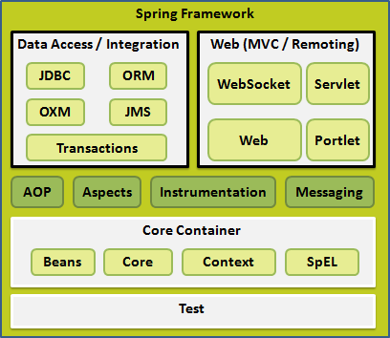
Modules
Spring is Modular and it gives us the flexibility to pick and use the modules that are applicable to us.

Slide 4
IoC Container
Spring IoC Container creates the objects, wires them together, configures them, and manages their complete lifecycle till destruction.
The container gets the instructions on what object to instantiate, configure, and assemble by reading the metadata configuration provided.
The metadata configuration can be represented by XML or by Annotation.

Slide 5
IoC Container – Contd.
Spring provides two types of containers, through which we can configure the beans
BeanFactory: This is the simplest container, that provides the basic support of DI.
ApplicationContext: It includes all functionalities of the BeanFactory Container. It addes more enterprise-specific functionalities such as ability to resolve textual messages from a properties file.
Application Context is preferred over BeanFactory.
BeanFactory can be used for light weight Mobile applications or applet based applications.

Slide 6
Bean Definition
<beans xmlns="http://www.springframework.org/schema/beans" xmlns:xsi="http://www.w3.org/2001/XMLSchema-instance" xsi:schemaLocation="http://www.springframework.org/schema/beans http://www.springframework.org/schema/beans/spring-beans-3.0.xsd">
<bean id="..." class="...">
</bean>
<bean id="..." class="...">
</bean>
<beans>
Here <bean> tag indicates the bean,
id attribute indicates the unique id of the bean object
Class attribute indicates the fully qualified Class Name.
‘n’ number of beans can be enclosed within <beans> tag.

Slide 7
Bean Injection
By following ways, we shall injection a bean
Setter injection: Injection the values of the properties through the setter methods.
<bean id=“personObj" class="com.example.Person">
<property name="name" value=“Ramesh"/>
<property name=“age" value=“28"/>
</bean>
Construction injection: Injection through the Constructor.
<bean id=“personObj" class="examples.Person">
<constructor-arg index="0" value=“Ramesh"/>
<constructor-arg index="1" value=“28"/>
</bean>
Any one of these two ways can be picked based on the need.
Construction injection is suitable only if all the parameters in the constructor are mandatory.

Slide 8
Bean Scopes
Spring supports following scopes –
Commonly used scopes -
Singleton – Default Scope.
prototype
Used in Web Applications -
request
session
global-session
Syntax:
<bean id="..." class="..." scope="singleton"> ….</bean>

Slide 9
Bean Life Cycle
These are the two life cycles of a bean –
Initialization
Destruction
Flexibility to define the init() and destroy() method using the init-method and destroy-method attribute.
Ex: <bean id="exampleBean" class="examples.ExampleBean" init-method="init“ destroy-method="destroy"/>

Slide 10
Bean Postprocessors
BeanPostProcessor interface helps us to implement custom logic before and after the Bean is initialized.
Multiple post processors can be plugged in.
Can be implemented by overriding following two methods –
postProcessBeforeInitialization()
postProcessAfterInitialization()

Slide 11
Dependency Injection
Dependency Injection or Wiring helps the classes to group together.
In real time, we will have a class associated with another class (HAS-A) relationship.
In the below example, we configure in such a way that, the object of the Address is created, while creating the object of Employee. ‘ref’ attribute is used for wiring between classes. Example -
class Employee {
private int age;
private Address addr;
//Getters and setters
}
Configured as –
<bean id=“employeeBean" class="com.bean.Employee">
<property name=“addr" ref=“addressBean"/>
</bean>
<bean id=“addressBean" class="com.bean.Address">
</bean>

Slide 12
Injecting Collections
Spring provides support to inject the Collection through following tags
<list> - Helps to inject a List
<set> - Helps to inject a Set
<map> - Helps to inject a Map

